Slide 1
Introduction
Dr. RAJIB MALL
Professor
Department Of Computer Science & Engineering
IIT Kharagpur.

Slide 2

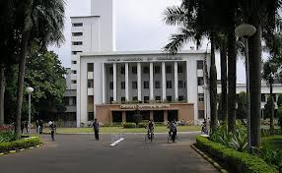
About The Instructor
RAJIB MALL
B.E. , M.E., Ph.D from Indian Institute of Science, Bangalore
Worked with Motorola (India)
Shifted to IIT, Kharagpur in 1994
  Currently Professor and HOD

Slide 3
Review Questions
What is the difference between abstraction and decomposition?
How are these two concepts useful in software engineering?

Slide 4


What is Software Engineering?
Engineering approach to develop software.
  Building Construction Analogy.
Systematic collection of past experience:
  Techniques,
  Methodologies,
  Guidelines.

Slide 5
Techniques versus Methodology…
Many times used interchangeably…
Dictionary:
  Technique: a systematic procedure, formula, or a routine by which a task is accomplished.
  Method: A habitual, logical, or prescribed practice or a preordained sequence of achieving certain end results with accuracy and efficiency.
    However, when a method is systematic and based upon logic, it is referred to as a scientific method.

Slide 6
Jobs versus Projects?
Uncertainty of outcome
Routine
Jobs
Projects
Exploration
Jobs – repetition of very well-defined and well understood tasks with very little uncertainty
Exploration – The outcome is very uncertain, e.g. finding a cure for cancer.
Projects – in the middle! Has challenge as well as routine…
Notes:
On the one hand there are repetitive jobs a similar task is carried out repeatedly, for example Kwikfit replacing a tyre on a car or a lecturer giving an introductory talk on project management. The task is well-defined and there is very little uncertainty. In some organizations, software development might tend to be like this – in these environments software process management might be more important than software project management
On the other hand some exploratory activities are very uncertain. Some research projects can be like this – we may not be sure what the outcome will be, but we hope that we will learn some things of importance. It may be very difficult to come up with precise plans, although we would probably have some idea of a general approach.
Projects seem to come somewhere between these two extremes. There are usually well-defined hoped-for outcomes but there are risks and uncertainties about achieving those outcomes.

Slide 7
IEEE Definition
“Software engineering is the application of a systematic, disciplined, quantifiable approach to the development, operation, and maintenance of software; that is, the application of engineering to software.”

Slide 8
Technology Development Pattern
Programming an Art or Engineering?
Engineering
Esoteric Past
Experience
Technology
Craft
Systematic Use of Past
Experience and Scientific Basis
Unorganized Use of
Past Experience
Art
Time

Slide 9
Programming an Art or Engineering?
Heavy use of past experience:
  Past experience is systematically arranged.
Theoretical basis and quantitative techniques provided.
Many are just thumb rules.
Tradeoff between alternatives.
Pragmatic approach to cost-effectiveness.

Slide 10

What is Exploratory Development?
Early programmers used an exploratory (also called build and fix) style.
  A `dirty' program is quickly developed.
  The bugs are fixed as and when they are noticed.
  Similar to a junior student develops programs…

Slide 11
Exploratory Style
Fix
Initial
Coding
Test
Do Until Done
Does not work for nontrivial projects…
Why?...

Slide 12
What is Wrong with the Exploratory Style?
Can successfully be used for developing very small (toy) programs.
Software
Engineering
Exploratory
Effort, time, cost
Machine
Program Size

Slide 13
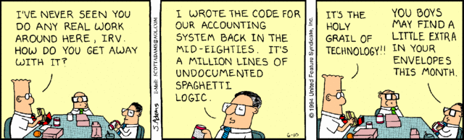
Dilbert: Scott Adams

Slide 14

Our Project Manager: Ponty Haired Boss
Hopelessly incompetent at management. He does not understand technical issues but always tries to disguise this, usually by using buzzwords that he does not understand himself. Often lacks Ethics…

Slide 15
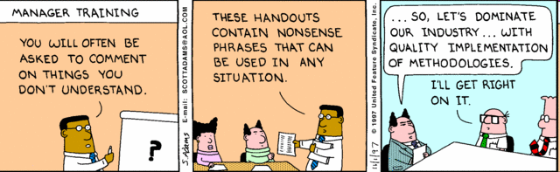

Slide 16

Dogbert
Consultant ---
Low on ethics--- Loves
conning and insulting people---
When hired as a consultant to create a new company logo, Dogbert proposed using a piece of paper with a circular stain from his coffee cup as the Brown Ring of Quality.
Dilbert
Competent ---
Bit arrogant – Low on Ethics

Slide 17
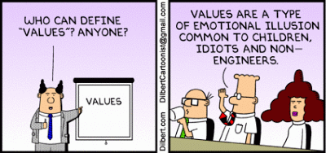

Slide 18
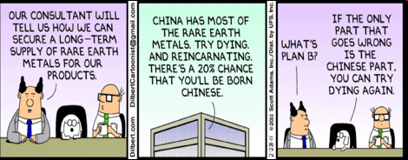

Slide 19
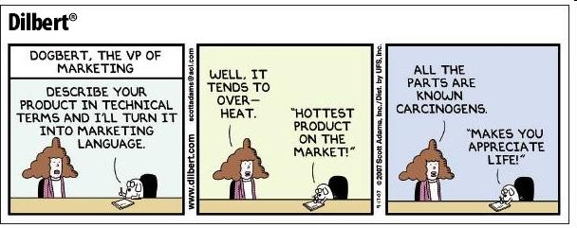

Slide 20

Asok graduated from the Indian Institute of Technology (IIT). Asok's test scores (a perfect 1600 on the old SAT) and the fact his IQ is 240, show that he is the smartest member of the engineering team. He is often called upon by the Boss to do odd jobs and his ideas are usually left hanging in the meetings. There are a few jokes about him having psychic powers which he learned at the IIT. Yet despite his intelligence, ethics and mystical powers, Asok sometimes takes advice from Wally in the arts of laziness, and Dilbert in surviving the office.

Slide 21
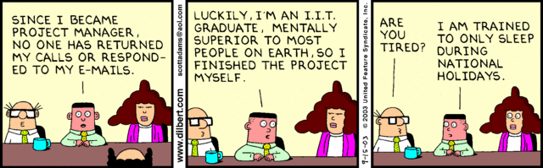

Slide 22
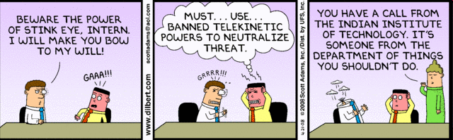

Slide 23
What is Wrong with the Exploratory Style? Cont…
Besides the exponential growth of effort, cost, and time with problem size:
  Exploratory style usually results in unmaintenable code.
  It becomes very difficult to use the exploratory style in a team development environment…

Slide 24
What is Wrong with the Exploratory Style? Cont…
Why does the effort required to develop a software grow exponentially with size?
  Why does the approach completely breaks down when the size of required software becomes large?
Software
Engineering
Exploratory
Effort, time, cost
Machine
Program Size

Slide 25
An Interpretation Based on Human
Cognition Mechanism
Human memory can be thought to be made up of two distinct parts [Miller 56]:
  Short term memory and
  Long term memory.

Slide 26

Human Cognition Mechanism
Suppose I ask: “If it is 10:10AM now, how many hours are remaining today?"
  10AM would be stored in the short-term memory.
  “A day is 24 hours long.” would be fetched from the long term memory into short term memory.
  The mental manipulation unit would compute the difference (24-10).

Slide 27
Schematic Representation of Brain
Short Term Memory
Processing Center
Long Term Memory
Brain

Slide 28
Short Term Memory
An item stored in the short term memory can get lost:
  Either due to decay with time or
  Displacement by newer information.
This restricts the time for which an item is stored in short term memory:
  Typically few tens of seconds.
  However, an item can be retained longer in the short term memory by recycling.

Slide 29
What is an Item?
An item is any set of related information.
  A character such as `a' or a digit such as `5'.
  A word, a sentence, a story, or even a picture.
Each item normally occupies one place in memory.
When you are able to relate several different items together (chunking):
  The information that should normally occupy several places, takes only one place in memory.

Slide 30
Chunking
If you are given the binary number 110010101001
  It may prove very hard for you to understand and remember.
  But, the octal form of 6251 (110)(010)(101)(001) would be easier.
  You have managed to create chunks of three items each.

Slide 31
Evidence of Short Term Memory
In many of our day-to-day experiences:
  Short term memory is evident.
Suppose, you look up a number from the telephone directory and start dialling it.
  If you find the number is busy, you can dial the number again after a few seconds without having to look up the directory.
But, after several days:
  You may not remember the number at all
  Would need to consult the directory again.

Slide 32
The Magical Number 7
If a person deals with seven or less number of items:
  These would be accommodated in the short term memory.
  So, he can easily understand it.
As the number of new information increases beyond seven:
  It becomes exceedingly difficult to understand it.

Slide 33
What is the Implication in Program Development?
A small program having just a few variables:
  Is within easy grasp of an individual.
As the number of independent variables in the program increases:
  It quickly exceeds the grasping power of an individual…
  Requires an unduly large effort to master the problem.

Slide 34
Implication in Program Development
Instead of a human, if a machine could be writing (generating) a program,
  The slope of the curve would be linear.
But, how does use of software engineering principles helps hold down the effort-size curve to be almost linear?
  Software engineering principles extensively use techniques specifically targeted to overcome the human cognitive limitations.

Slide 35
Which Principles Deployed by Software Engineering Techniques to Overcome Human Cognitive Limitations?
Two important principles are profusely used:
  Abstraction
  Decomposition

Slide 36
What is Abstraction?
Simplify a problem by omitting unnecessary details.
  Focus attention on only one aspect of the problem and ignore other aspects and irrelevant details.
  Also called model building.

Slide 37
Questions
What is a model?
Why develop a model? That is, how does a model help?
Give some examples of models.

Slide 38
Abstraction Example
Suppose you are asked to develop an overall understanding of some country.
  Would you:
    Meet all the citizens of the country, visit every house, and examine every tree of the country?
  You would possibly refer to various types of maps for that country only.

Slide 39


You would study an Abstraction…
A map is:
  An abstract representation of a country.
  Various types of maps (abstractions) possible.

Slide 40
Does a Problem have a single Abstraction?
Several abstractions of the same problem can be created:
  Focus on some specific aspect and ignore the rest.
  Different types of models help understand different aspects of the problem.

Slide 41
Abstractions of Complex Problems
For complex problems:
  A single level of abstraction is inadequate.
  A hierarchy of abstractions may have to be constructed.
Hierarchy of models:
  A model in one layer is an abstraction of the lower layer model.
  An implementation of the model at the higher layer.

Slide 42
Complex Problem Abstraction Example
Suppose you are asked to understand all life forms that inhabit the earth.
Would you start examining each living organism?
  You will almost never complete it.
  Also, get thoroughly confused.
Solution: You can try to build an abstraction hierarchy.

Slide 43
Living Organisms
Kingdom
Animalia
Plantae
Fungae
Mollusca
Chordata
Ascomycota
Zygomycota
Phyllum
Species
Homo Sapien
Solanum Tuberosum
Coprinus Comatus

Slide 44
Decomposition
Decompose a problem into many small independent parts.
  The small parts are then taken up one by one and solved separately.
  The idea is that each small part would be easy to grasp and therefore can be easily solved.
  The full problem is solved when all the parts are solved.

Slide 45


Decomposition
A popular use of decomposition principle:
  Try to break a bunch of sticks tied together versus breaking them individually.
Any arbitrary decomposition of a problem may not help.
  The decomposed parts must be more or less independent of each other.

Slide 46
Decomposition Example
Example use of decomposition principle:
  You understand a book better when the contents are organized into independent chapters.
  Compared to when everything is mixed up.

Slide 47
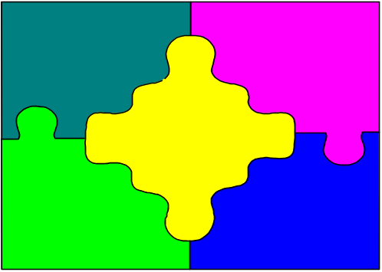
Why Study Software Engineering? (1)‏
To acquire skills to develop large programs.
  Handling exponential growth in complexity with size.
  Systematic techniques based on abstraction (modelling) and decomposition.

Slide 48
Why Study Software Engineering? (2)‏
Learn systematic techniques of:
  Specification, design, user interface development, testing, project management, etc.
  Appreciate issues that arise in team development.

Slide 49
Why Study Software Engineering? (3)‏
To acquire skills to be a better programmer:
    Higher Productivity
    Better Quality Programs

Slide 50
Software Crisis
It is often the case that software products:
  Fail to meet user requirements.
  Expensive.
  Difficult to alter, debug, and enhance.
  Often delivered late.
  Use resources non-optimally.

Slide 51
Software Crisis (cont.)‏
Laptop or Desktop = Rs.45,000/-
Rational rose node locked = Rs.314,600/-
Rational rose floating license= Rs.603,200/-
Hw cost
Sw cost
1960
Year
2014
Relative Cost of Hardware and Software

Slide 52
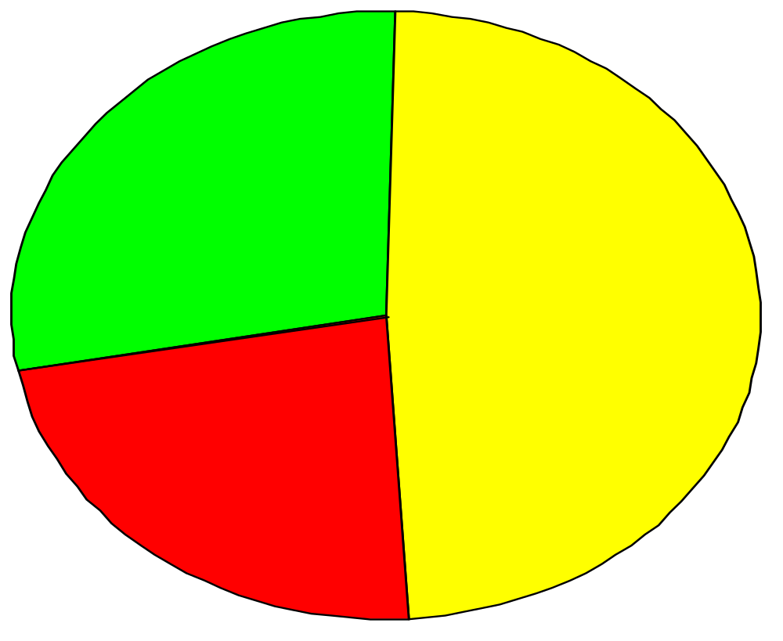
Standish Group Report
28% Successful
49% Delayed or cost overrun
23% Cancelled

Slide 53
Then why not have entirely hardware systems?
A virtue of software:
  Relatively easy to change
  Otherwise it might as well be hardware
The more the complexity of a software (Entropy), the harder it is to change--why?
  Further, the more the changes made to a program, the greater is the increase in its entropy.

Slide 54
Which Factors are Contributing to the Software Crisis?
Larger problems,
Poor project management
Lack of adequate training in software engineering,
Increasing skill shortage,
Low productivity improvements.

Slide 55
Programs versus Software Products
Large
Large number of users
Team of developers
Well-designed interface
Well documented & user-manual prepared
Systematic development
Usually small in size
Author himself is sole user
Single developer
Lacks proper user interface
Lacks proper documentation
Ad hoc development.

Slide 56
Types of Software Projects
Two types of software projects:
  Products (Generic software)‏
  Services (custom software)‏
Total business – appx. $1 Trillion
  Half in products and half services
  Services segment is growing fast!

Slide 57
Types of Software
Horizontal market software—meets needs of many companies
Packaged software—prewritten software available for purchase
Vertical market software—designed for particular industry
Custom software—software developed at user’s request
Custom software-Developer tailors his generic solution

Slide 58
Types of Software Projects
Software product development projects
Software services projects

Slide 59

Software Services
Software service is an umbrella term, includes:
  Software customization
  Software maintenance
  Software testing
  Also contract programmers who carry out coding or any other assigned activities.
CP

Slide 60
Scenario of Indian Software Companies
Indian companies have focused on the services segment --- Why?

Slide 61
A Few Changes in Software Project Characteristics over Last 40 Years
40 years back, very few software existed
  Every project started from scratch
  Projects were multi year long
The programming languages that were used hardly provided any scope for reuse:
  FORTRAN, PASCAL, COBOL, BASIC
No application was GUI-based:
  Mostly command selection from displayed text menu items.

Slide 62
Traditional versus Modern Projects
Projects are increasingly becoming services:
  Either tailoring some existing software or reusing certain pre-built libraries.
Facilitation and accommodation of client feedbacks
Facilitation of customer participation in project development work
Incremental software delivery with evolving functionalities.
No software being developed from scratch --- Significant reuse
Notes:
Rather than making a long term project completion plan, the project manager now plans all incremental deliveries with evolving functionalities. This type of project management is often called Extreme project management.

Slide 63
Computer Systems Engineering
Computer systems engineering:
  encompasses software engineering.
Many products require development of software as well as specific hardware to run it:
  a coffee vending machine,
  a sophisticated toy,
  A new smart phone, etc.

Slide 64
Computer Systems Engineering
The high-level problem:
  Deciding which tasks are to be solved by software.
  Which ones by hardware.

Slide 65
Computer Systems Engineering (CONT.)
Typically, hardware and software are developed together:
  Hardware simulator is used during software development.
Integration of hardware and software.
Final system testing

Slide 66
Computer Systems Engineering (CONT.)
Feasibility
Study
Requirements Analysis and Specification
Hardware Development
Hardware Software Partitioning
Software Development
Integration
and Testing
Project Management

Slide 67
Emergence of Software Engineering
Early Computer Programming (1950s):
  Programs were being written in assembly language…
  Sizes limited to about a few hundreds of lines of assembly code…

Slide 68
Early Computer Programming (50s)‏
Every programmer developed his/her own style of writing programs:
  According to his intuition (exploratory programming).

Slide 69
High-Level Language Programming (Early 60s)‏
High-level languages such as FORTRAN, ALGOL, and COBOL were introduced:
  This reduced software development efforts greatly.
  Why reduces?

Slide 70
High-Level Language Programming (Early 60s)‏
Software development style was still exploratory.
  Typical program sizes were limited to a few thousands of lines of source code.

Slide 71
Control Flow-Based Design (late 60s)‏
Size and complexity of programs increased further:
  Exploratory programming style proved to be insufficient.
Programmers found:
  Very difficult to write cost-effective and correct programs.

Slide 72
Control Flow-Based Design (late 60s)‏
Programmers found it very difficult:
  To understand and maintain programs written by others.
To cope up with this problem, experienced programmers advised---”Pay particular attention to the design of the program's control structure.'’

Slide 73
Control Flow-Based Design (late 60s)
A program's control structure indicates:
  The sequence in which the program's instructions are executed.
To help design programs having good control structure:
  Flow charting technique was developed.

Slide 74
Control Flow-Based Design (late 60s)
Using flow charting technique:
  One can represent and design a program's control structure.
  Usually one understands a program:
    By mentally simulating the program's execution sequence.

Slide 75
Control Flow-Based Design
(Late 60s)‏
A program having a messy flow chart representation:
  Difficult to understand and debug.

Slide 76
Control Flow-Based Design (Late 60s)‏
It was found:
  GO TO statements makes control structure of a program messy.
  GO TO statements alter the flow of control arbitrarily.
  The need to restrict use of GO TO statements was recognized.

Slide 77
Control Flow-Based Design (Late 60s)
Many programmers had extensively used assembly languages.
  JUMP instructions are frequently used for program branching in assembly languages.
  Programmers considered use of GO TO statements inevitable.

Slide 78
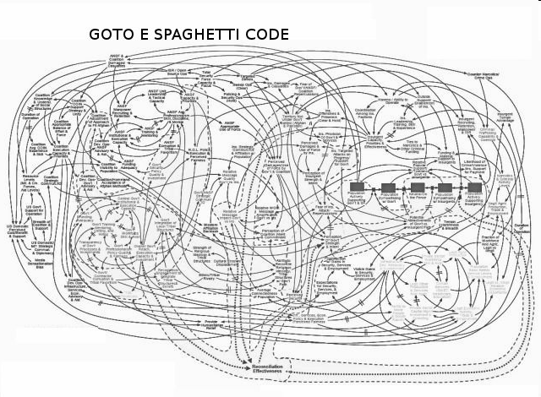
Spaghetti Code Structure

Slide 79
Control-flow Based Design (Late 60s)‏
At that time, Dijkstra published his article:
  “Goto Statement Considered Harmful” Comm. of ACM, 1969.
Many programmers were unhappy to read his article.

Slide 80
Control Flow-Based Design (Late 60s)
They published several counter articles:
  Highlighted the advantages and inevitability of GO TO statements.

Slide 81
Control Flow-Based Design (Late 60s)
It soon was conclusively proved:
  Only three programming constructs are sufficient to express any programming logic:
    sequence (a=0;b=5;)‏
    selection (if(c==true) k=5 else m=5;)‏
    iteration (e.g. while(k>0) k=j-k;)‏

Slide 82
Control-flow Based Design (Late 60s)‏
Everyone accepted:
  It is possible to solve any programming problem without using GO TO statements.
  This formed the basis of Structured Programming methodology.

Slide 83
Structured Programming
A program is called structured:
  When it uses only the following types of constructs:
    sequence,
    selection,
    iteration

Slide 84
Structured Programs
Unstructured control flows are avoided.
Consist of modules.
Use single-entry, single-exit program constructs.

Slide 85
Structured Programs
However, violations to this feature are permitted:
  Due to practical considerations such as:
  Premature loop exit (break) to support exception handling.

Slide 86
Structured programs
Structured programs are:
  Easier to read and understand,
  Easier to maintain,
  Require less effort and time for development.

Slide 87
Structured Programming
Research experience shows:
  Programmers commit less number of errors:
    While using structured if-then-else and do-while statements.
    Compared to test-and-branch constructs.

Slide 88
Data Structure-Oriented Design (Early 70s)‏
Soon it was discovered:
  It is important to pay more attention to the design of data structures of a program
    Than to the design of its control structure.

Slide 89
Data Structure-Oriented Design (Early 70s)‏
Techniques which emphasize designing the data structure:
  Derive program structure from it:
    Are called data structure-oriented design techniques.

Slide 90
Data Structure Oriented Design (Early 70s)‏
Example of data structure-oriented design technique:
  Jackson's Structured Programming(JSP) methodology
    Developed by Michael Jackson in 1970s.

Slide 91
Data Structure Oriented Design (Early 70s)‏
JSP technique:
  Program code structure should correspond to the data structure.

Slide 92
Data Structure Oriented Design (Early 70s)‏
JSP methodology:
  A program's data structures are first designed using notations for
    sequence, selection, and iteration.
  Then data structure design is used :
    To derive the program structure.

Slide 93
Data Structure Oriented Design (Early 70s)‏
Several other data structure-oriented Methodologies also exist:
  e.g., Warnier-Orr Methodology.

Slide 94
Data Flow-Oriented Design (Late 70s)
Data flow-oriented techniques advocate:
  The data items input to a system must first be identified,
  Processing required on the data items to produce the required outputs should be determined.

Slide 95
Data Flow-Oriented Design (Late 70s)‏
Data flow technique identifies:
  Different processing stations (functions) in a system.
  The items (data) that flow between processing stations.

Slide 96
Data Flow-Oriented Design (Late 70s)‏
Data flow technique is a generic technique:
  Can be used to model the working of any system.
    not just software systems.
A major advantage of the data flow technique is its simplicity.

Slide 97

Data Flow Model of a Car Assembly Unit
Engine Store
Door Store
Partly Assembled Car
Chassis with Engine
Fit
Engine
Fit
Wheels
Paint and
Test
Car
Fit
Doors
Assembled Car
Chassis Store
Wheel Store

Slide 98
Object-Oriented Design (80s)‏
Object-oriented technique:
  An intuitively appealing design approach:
  Natural objects (such as employees, pay-roll-register, etc.) occurring in a problem are first identified.

Slide 99
Object-Oriented Design (80s)‏
Relationships among objects:
  Such as composition, reference, and inheritance are determined.
Each object essentially acts as:
  A data hiding (or data abstraction) entity.

Slide 100
Object-Oriented Design (80s)‏
Object-Oriented Techniques have gained wide acceptance:
  Simplicity
  Increased Reuse possibilities
  Lower development time and cost
  More robust code
  Easy maintenance

Slide 101
Evolution of Design Techniques
Aspect-oriented
Component-based
Service-oriented
Object-Oriented
Object-Oriented
Data flow-based
Data structure-based
Control flow-based
Ad hoc

Slide 102
Evolution of Other Software Engineering Techniques
The improvements to the software design methodologies
  are indeed very conspicuous.
In additions to the software design techniques:
  Several other techniques evolved.

Slide 103
Evolution of Other Software Engineering Techniques
Life cycle models,
Specification techniques,
Project management techniques,
Testing techniques,
Debugging techniques,
Quality assurance techniques,
Metrics,
CASE tools, etc.

Slide 104
Differences between the exploratory style and modern software development practices
Use of Life Cycle Models
Software is developed through several well-defined stages:
  Requirements analysis and specification,
  Design,
  Coding,
  Testing, etc.

Slide 105
Differences between the exploratory style and modern software development practices
Emphasis has shifted
  from error correction to error prevention.
Modern practices emphasize:
  detection of errors as close to their point of introduction as possible.

Slide 106
Differences between the exploratory style and modern software development practices (CONT.)‏
In exploratory style,
  errors are detected only during testing,
Now:
  Focus is on detecting as many errors as possible in each phase of development.

Slide 107
Differences between the exploratory style and modern software development practices (CONT.)‏
In exploratory style:
  coding is synonymous with program development.
Now:
  coding is considered only a small part of program development effort.

Slide 108
Differences between the exploratory style and modern software development practices (CONT.)‏
A lot of effort and attention is now being paid to:
  Requirements specification.
Also, now there is a distinct design phase:
  Standard design techniques are being used.

Slide 109
Differences between the exploratory style and modern software development practices (CONT.)‏
During all stages of development process:
  Periodic reviews are being carried out
Software testing has become systematic:
  Standard testing techniques are available.

Slide 110
Differences between the exploratory style and modern software development practices (CONT.)‏
There is better visibility of design and code:
  Visibility means production of good quality, consistent and standard documents.
  In the past, very little attention was being given to producing good quality and consistent documents.
  We will see later that increased visibility makes software project management easier.

Slide 111
Differences between the exploratory style and modern software development practices (CONT.)‏
Because of good documentation:
  fault diagnosis and maintenance are smoother now.
Several metrics are being used:
  help in software project management, quality assurance, etc.

Slide 112
Differences between the exploratory style and modern software development practices (CONT.)‏
Projects are being prperly planned:
  estimation,
  scheduling,
  monitoring mechanisms.
Use of CASE tools.

Slide 113
Review Questions
Graphically represent the important activities carried out in the build and fix style of program development.
  What are the advantages and disadvantages of the build and fix style of software development?

Slide 114
Review Questions
When using exploratory style, why does the development time and effort increase exponentially with linear increase in software size?
What are the two basic mechanisms deployed by software engineering techniques to handle problem complexity?

Slide 115
Review Questions
What is software crisis? What are its symptoms and cure?
What is the difference between a programming job and assignment?
What are the different types of software projects undertaken by software development companies?

Slide 116
Review Questions
What is structured programming?
What problems may appear if a large program is being developed without using structured programming techniques?

